Slide 1
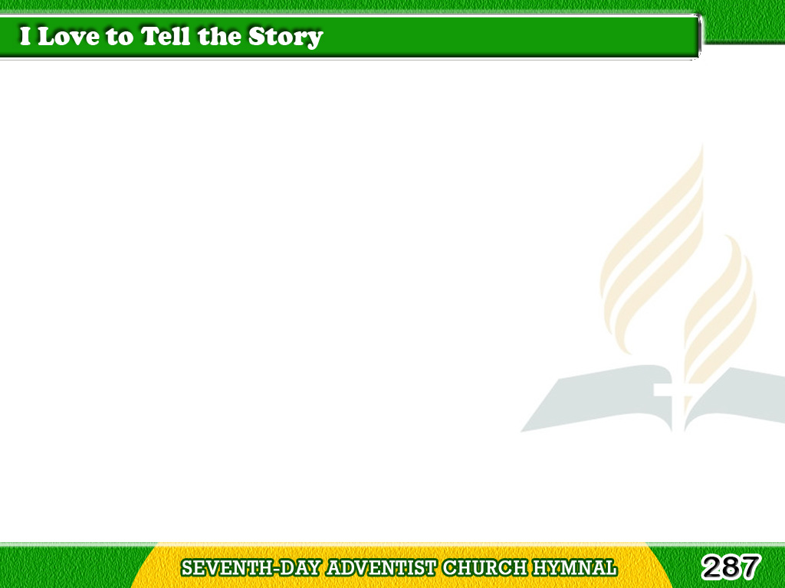
1/4
I love to tell the story
Of unseen things above,
Of Jesus and His glory,
Of Jesus and His love;
Tagalog
Version

Slide 2
1/4
I love to tell the story,
Because I know ‘tis true;
It satisfies my longing
As nothing else can do.
Tagalog
Version

Slide 3
1/4
Chorus
I love to tell the story;
‘Twill be my theme in glory
To tell the old, old story
Of Jesus and His love.
Tagalog
Version

Slide 4
2/4
I love to tell the story;
More wonderful it seems
Than all the golden fancies
Of all our golden dreams;
Tagalog
Version

Slide 5
2/4
I love to tell the story,
It did so much for me,
And that is just the reason
I tell it now to thee.
Tagalog
Version

Slide 6
2/4
Chorus
I love to tell the story;
‘Twill be my theme in glory
To tell the old, old story
Of Jesus and His love.
Tagalog
Version

Slide 7
3/4
I love to tell the story;
‘Tis pleasant to repeat
What seems each time I tell it,
More wonderfully sweet;
Tagalog
Version

Slide 8
3/4
I love to tell the story,
For some have never heard
The message of salvation
From God’s own holy word.
Tagalog
Version

Slide 9
3/4
Chorus
I love to tell the story;
‘Twill be my theme in glory
To tell the old, old story
Of Jesus and His love.
Tagalog
Version

Slide 10
4/4
I love to tell the story;
For those who know it best
Seem hungering and thirsting
To hear it like the rest;
Tagalog
Version

Slide 11
4/4
And when it scenes of glory
I sing the new, new song,
‘Twill be the old, old story
That I have loved so long.
Tagalog
Version

Slide 12
4/4
Chorus
I love to tell the story;
‘Twill be my theme in glory
To tell the old, old story
Of Jesus and His love.
Tagalog
Version

